Slide 1
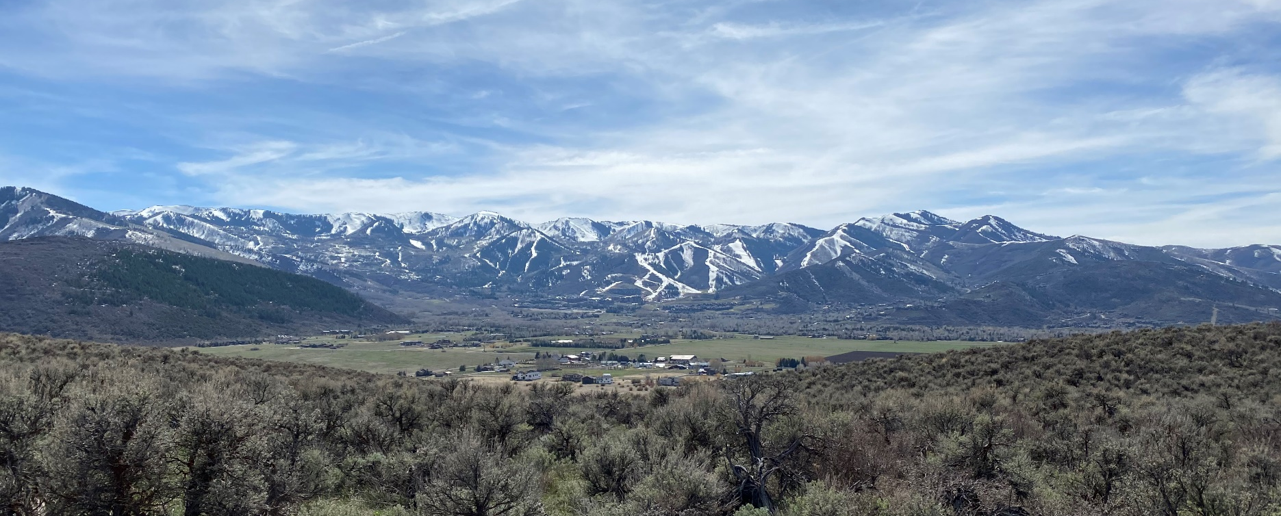

Mountain Regional Water SSD
Treatment Plant Expansion and WIFIA Presentation
June 11, 2025

Slide 2

Outline
Summarized District Overview
Project Information and Background
Parameters Resolution $61M
  $43M WIFIA FUNDING
  $18M 2023 Bond Refunding
Q&A

Slide 3
System Metrics
Approximately
6,067 connections
Standby Customers: 937
Area:
approximately
40 square miles
6.3 million gallons of drinking water delivered on peak day
9,200 GPM capacity at Lost Canyon pump station
2.6 MGD surface water treatment capacity
Interconnections:
  Regionalized many independent water systems
  7 emergency/wholesale with other water agencies
Sources/Distribution/Storage:
  16 groundwater wells
  Over 130 miles of pipe
  12.5 MG drinking water storage
  8.9 MG raw water storage
Notes:
Diversified – robust surface and water system

Slide 4
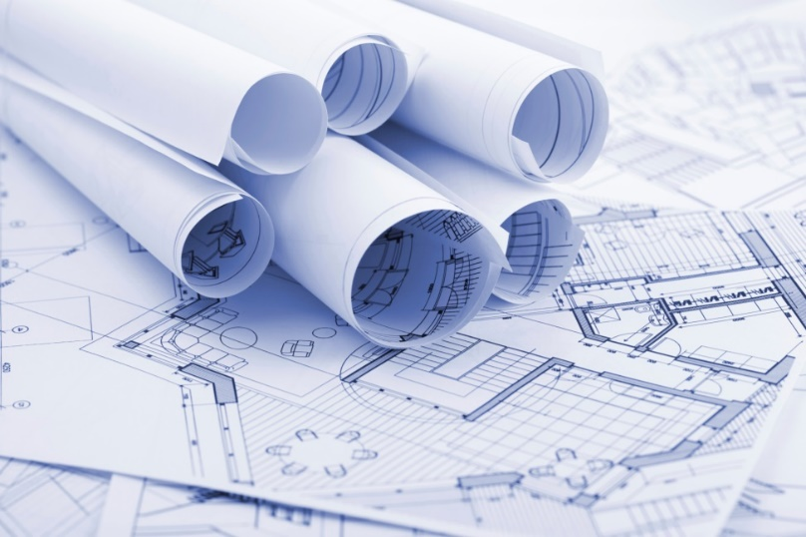
Who are we?
  More than 300 years combined experience in water service. 3 of 31 have been here since the District inception
  Licensed Civil Engineer
  Licensed Surveyor
  Licensed Contractor
  16 Operators certified at the highest level
  Masters in Business Administration
  Certified Public Accountant
  Certified Backflow Administrator
  Certified GIS Administrator
  Civil, Structural, Electrical Engineering Consultants

Slide 5
Water Delivery by Category

Slide 6
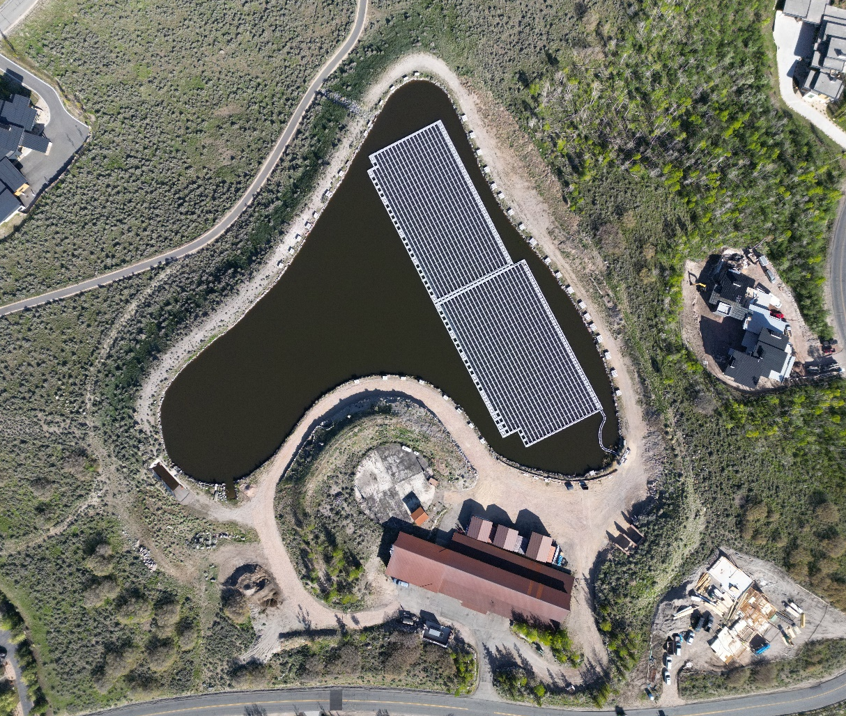
Project Information and
Background

Slide 7
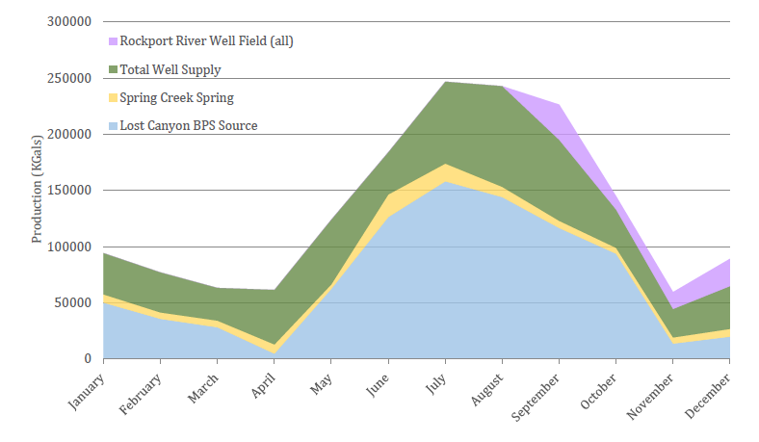
District Water Supply
  2020 example production year, monthly drinking water production from all facilities
  Peak day typically in July, with a ~3-week sustained window

Slide 8
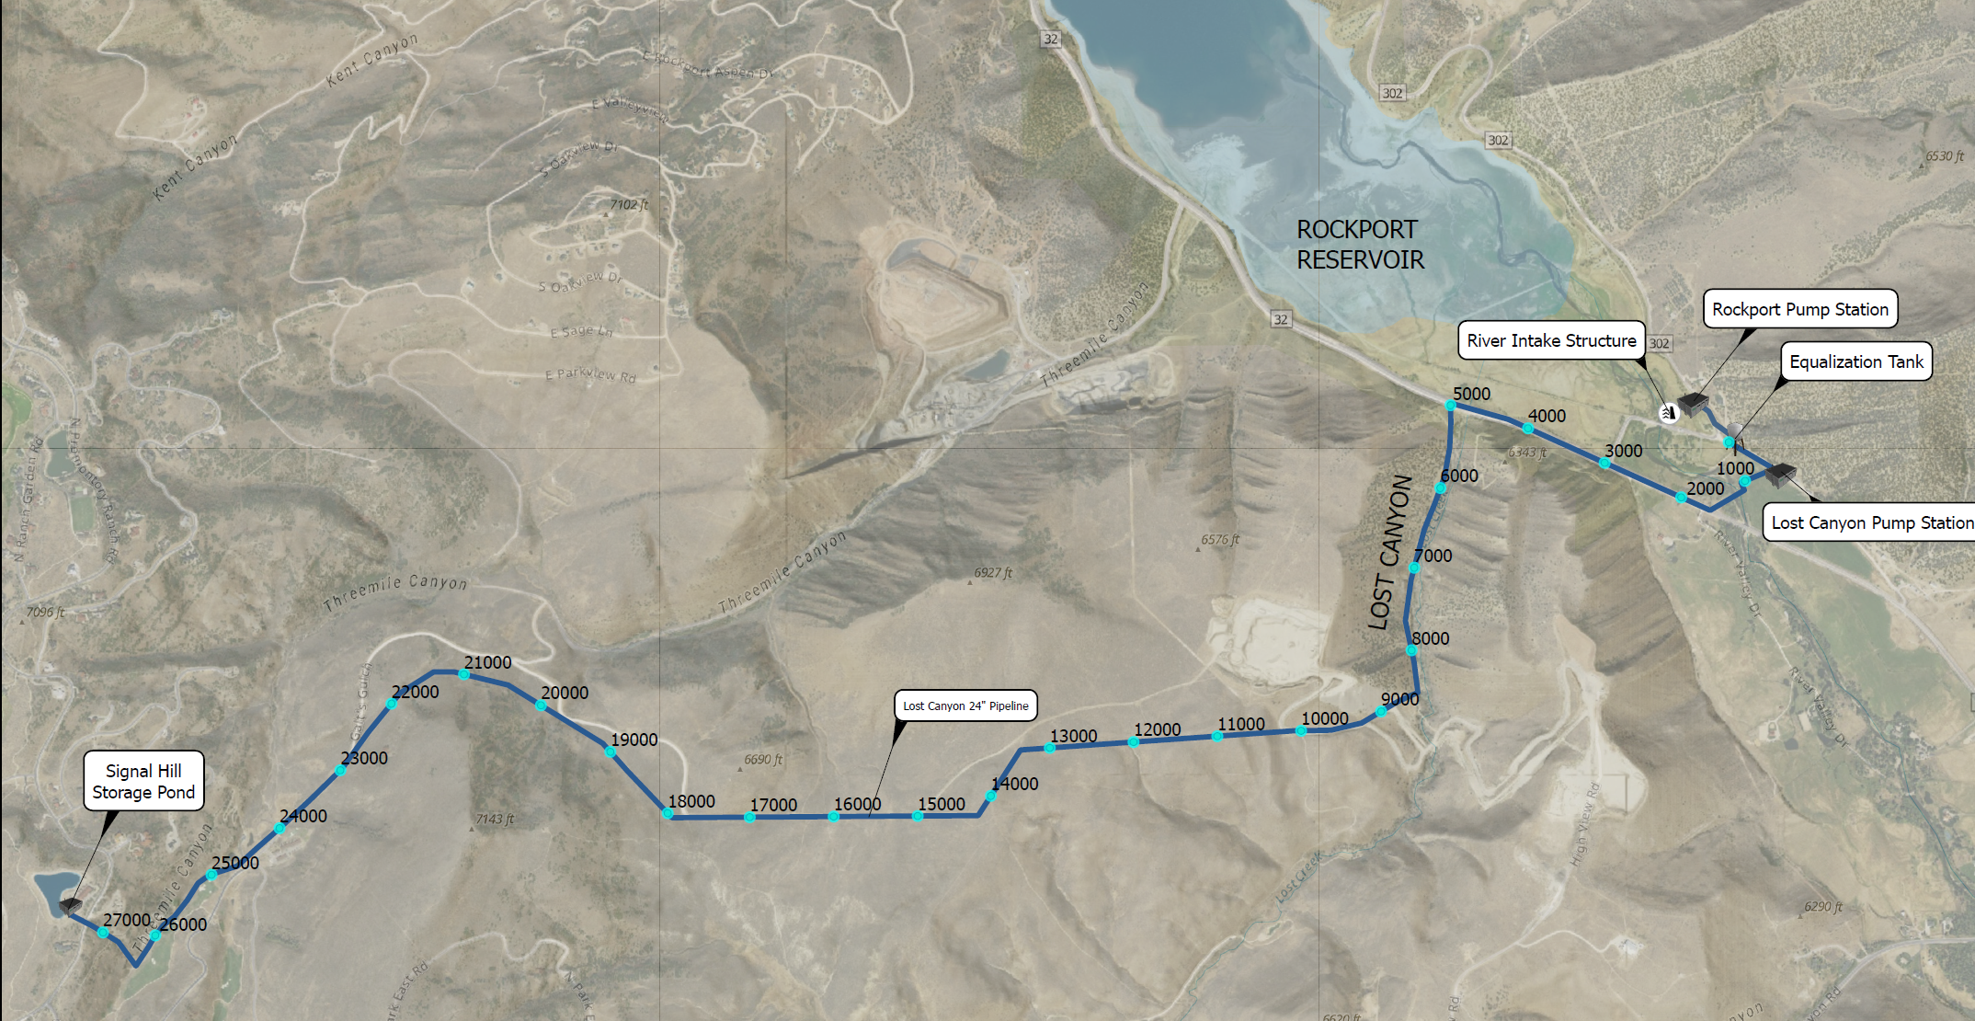
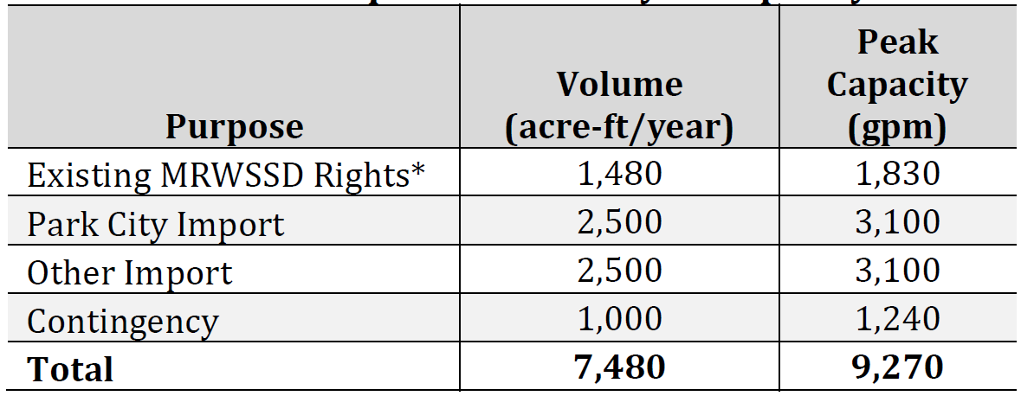
Lost Canyon System

Slide 9
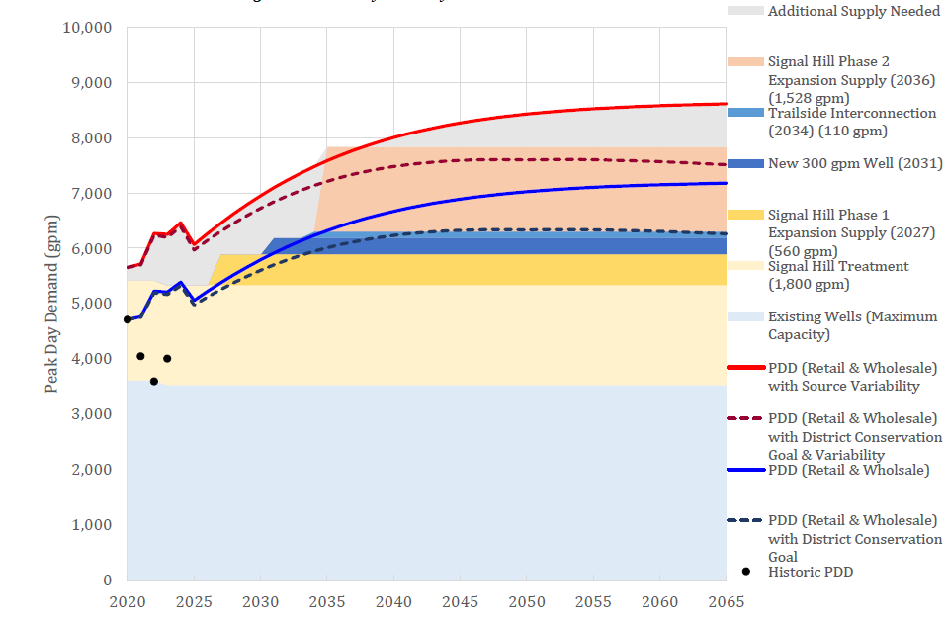
Master Planning Peak Day
Note Previous ‘Phased’ Approach
Master Plan Showing Source Development Critical

Slide 10
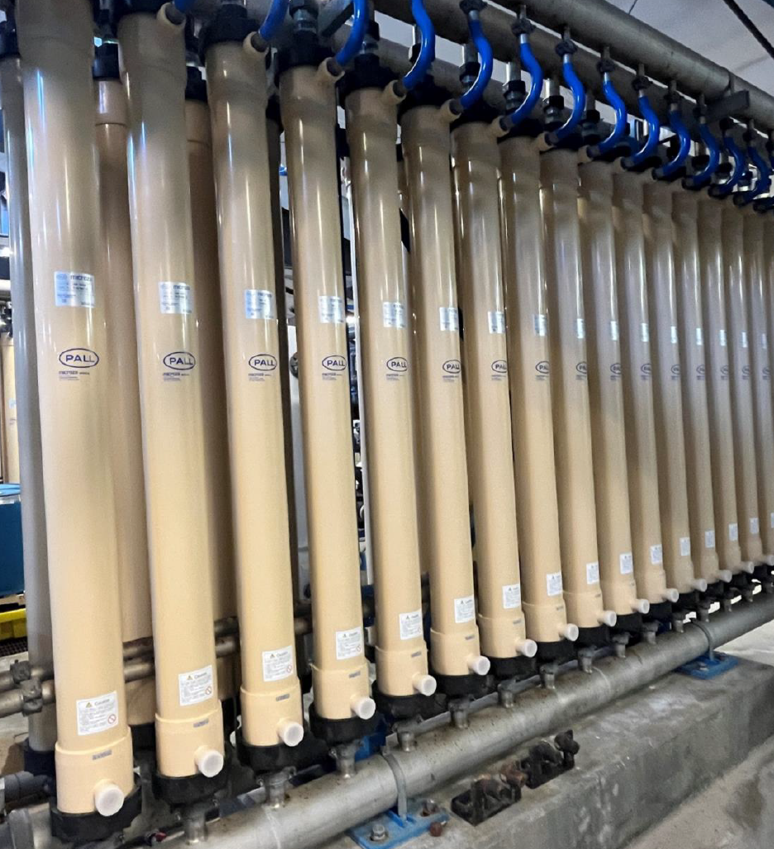
Project Objectives
  Meet increased demand
  Fully utilize Lost Canyon water
  Meet water quality objectives
  Increase safety
  Improve operations & maintenance
  Provide reliability/redundancy
  Future resilience (e.g., regulatory changes, wildfire, etc.)
  Capital and O&M costs

Slide 11
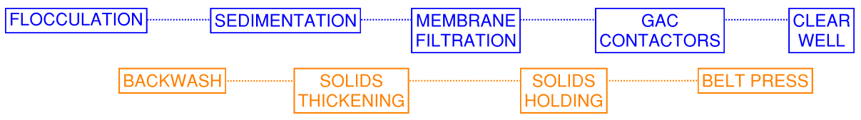
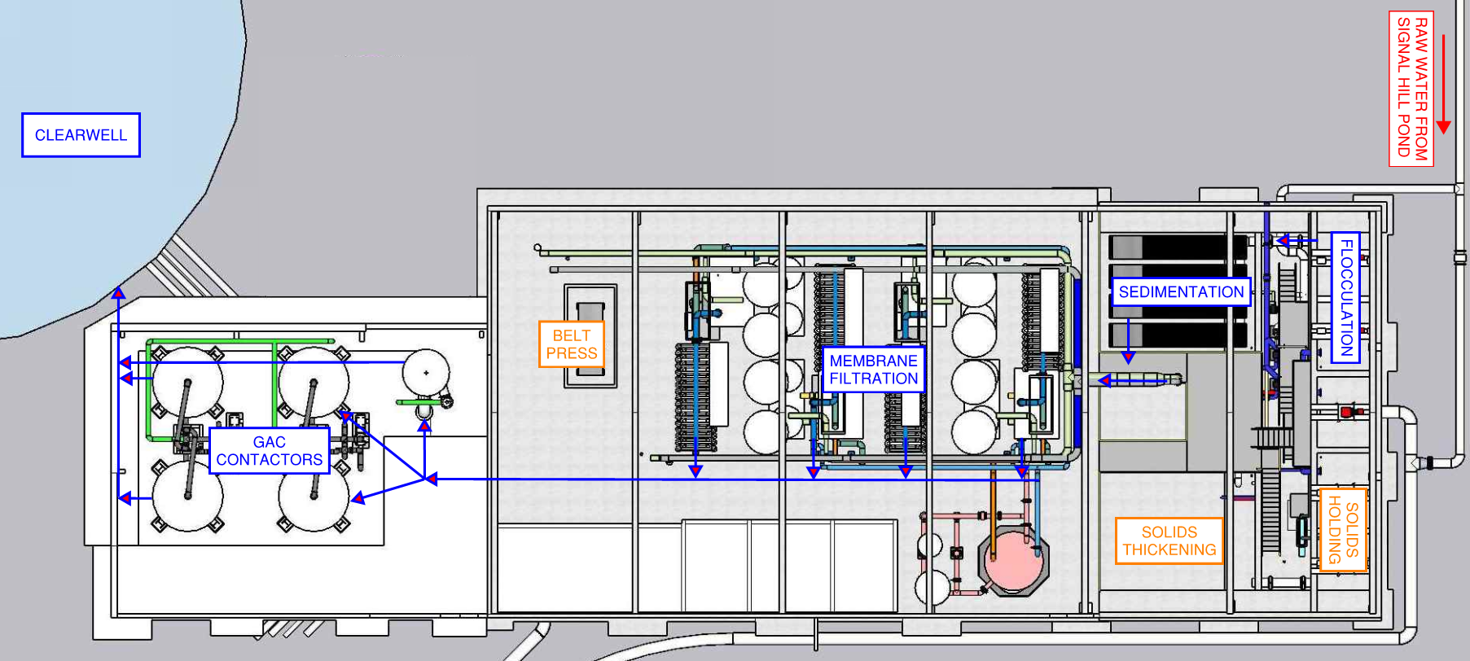
Existing Process Flow

Slide 12
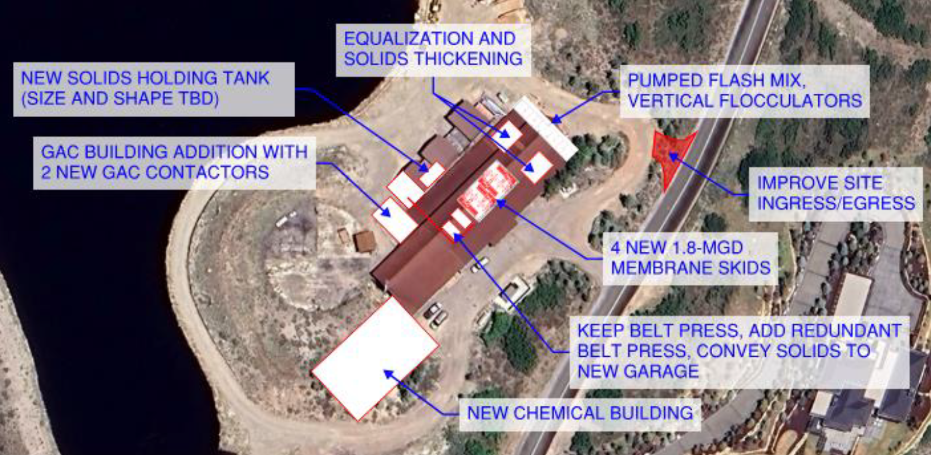
Proposed Project Layout
Notes:
Install a pumped flash mix system
Convert the flash mix basin and the solids holding tank into flocculation basins and install vertical flocculators
Convert to direct filtration.
Repurpose the existing sedimentation basin as a second solids thickening including a floating decanter
Replace the four existing membrane skids with four new 1.8-mgd skids
Maintain the existing belt filter press, install a redundant belt filter press, and convey cake solids to a new garage via a belt conveyor
Add two new GAC contactors within a GAC building extension northwest of the existing
Construct a new chemical facility southwest of the existing GAC building and include space for a future chlorine dioxide storage and feed system

Slide 13
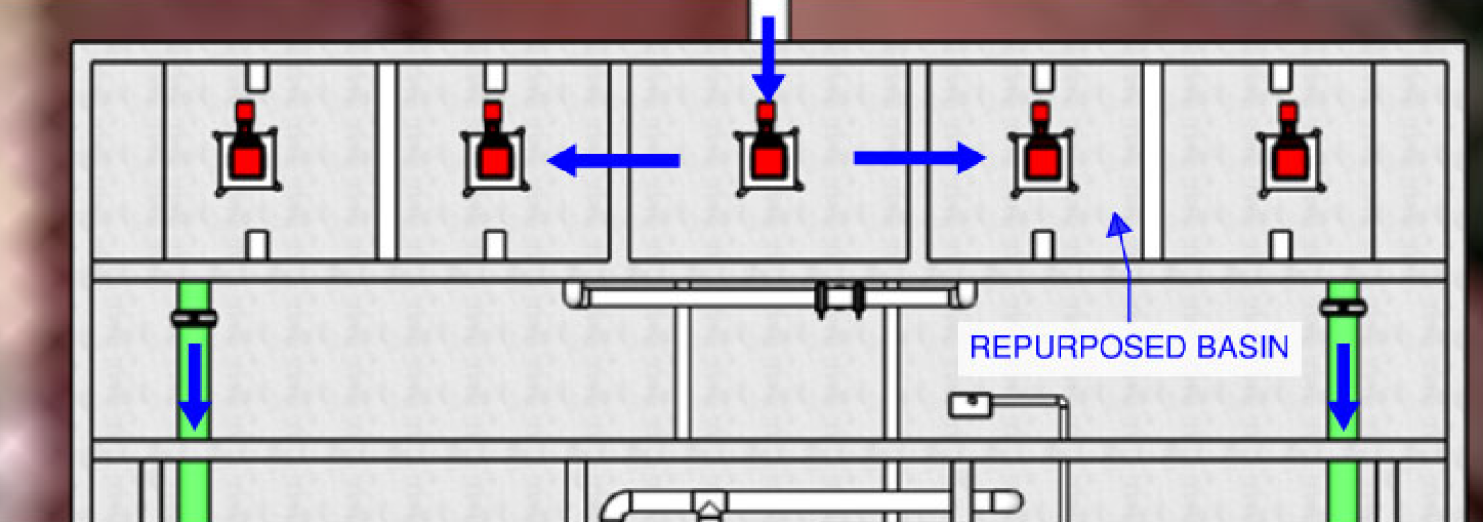
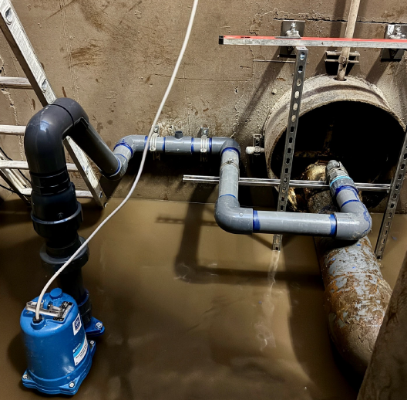
Flash Mix and Flocculation
  Reclaims solids holding tank for improved flocculation process
  Removes flawed bubble mixer and implements pumped flash mix
  Cost: $895,000
Notes:
Flocculation
Current fine-bubble floc system provides poor control and mixing
Convert repurposed solids basin for 3-stage flocculation (9 min total contact time)
Vertical hydrofoil mixers, dual-cell configuration with baffles to reduce short-circuiting
Flash Mix
Existing JDV Turbomixer is ineffective
Poor ACH mixing and TOC removal.
Replace with pumped diffusion mixing
Better chemical efficiency, lower power use, and easier retrofit.
Temporary system installed and performing well

Slide 14
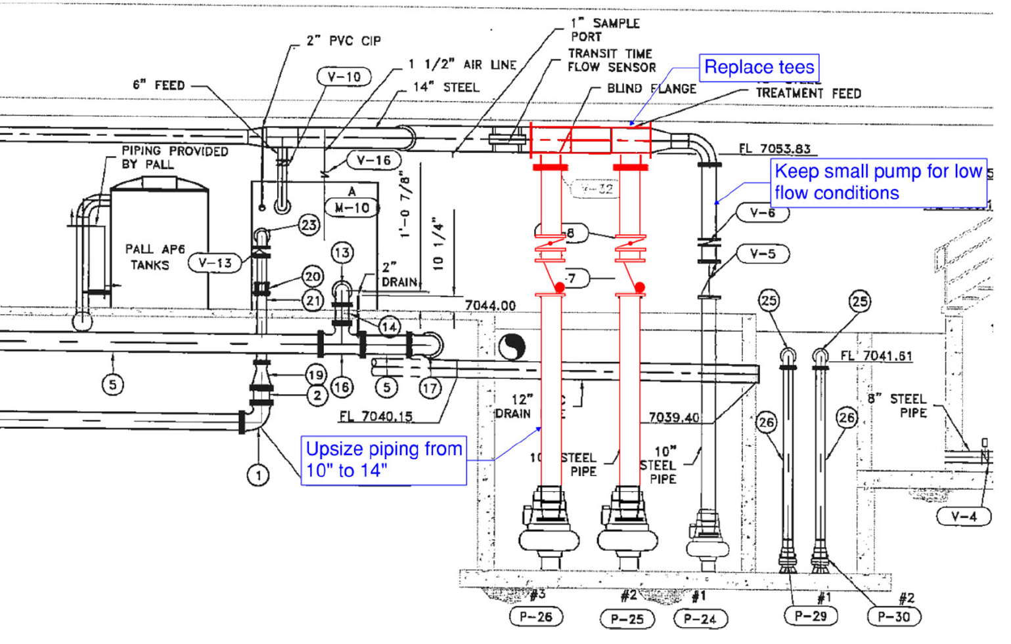
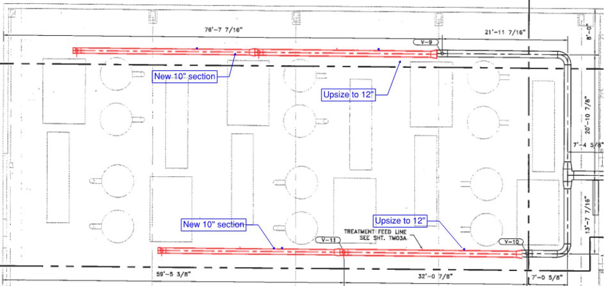
Direct Filtration and Membrane Wet Well
  Eliminates needs for sedimentation basins, $9M capital savings
  Increased capacity and new configuration
  Cost: $120,000
Notes:
Direct Filtration
Eliminates need for sedimentation basins → ~$9M capital cost savings
Proven at bench- and full-scale testing;
Membrane performance maintained or improved
Park City’s QJWTP uses same membranes and raw water without sedimentation or flocculation
Advantages
Fewer mechanical components → simpler operations and maintenance
Smaller treatment footprint
Implementation
Extend piping from flocculation basins to membrane wet well
Preserves floc time benefit over QJWTP
Space preserved for future sedimentation retrofit if needed

Slide 15
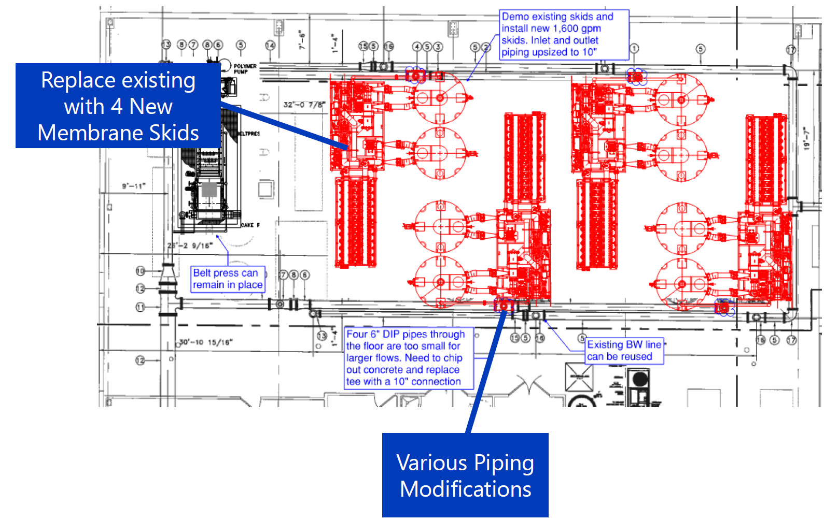
Membrane Filtration
  (4) new modular skids
    allows for 5.5 MGD
  Increases capacity, resiliency, and redundancy to the process
  Replaces aging (original) membrane hardware
  Cost: $15,125,000
Notes:
Current Capacity & Need
4 existing skids (38 modules each); firm capacity = 2.6 MGD
Peak summer demand exceeds capacity → no redundancy
Target: 5.4 MGD firm capacity with improved reliability
Future Membrane Alternative
4 New Modular Skids Replaces all existing skids with 4 new 1.8 MGD skids
Belt press stays; no backwash piping changes
Lower flux, adds resiliency to mitigate removal of sedimentation

Slide 16
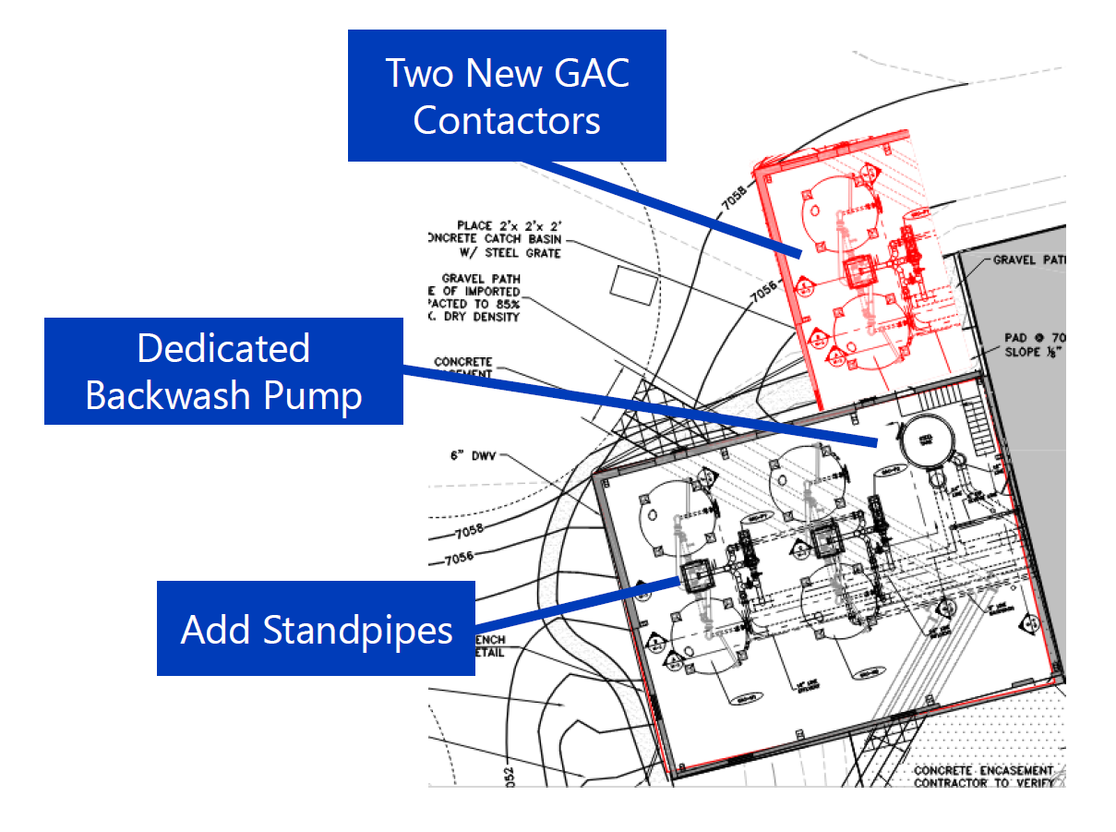
Granular Activated Carbon (GAC)
  GAC is primary removal of TOC in process
  Improved coagulation only requires (2) new vessels
  Other mechanical and pumping improvements
  Cost: $4,466,000
Notes:
Purpose & Performance Goals
GAC removes TOC to reduce DBP formation
Target: <2.0 mg/L TOC in finished water during summer
Enhanced coagulation (ACH) reduces GAC burden → fewer new vessels needed
Upgrades
Add 2 new contactors in building near pond
Accessible via new wall opening; maintains existing bypass tank
Less complex piping than other options
avoids chemical building conflict
Add shared backwash pump (no more paired shutdowns)
Add standpipe to keep lag vessels submerged

Slide 17
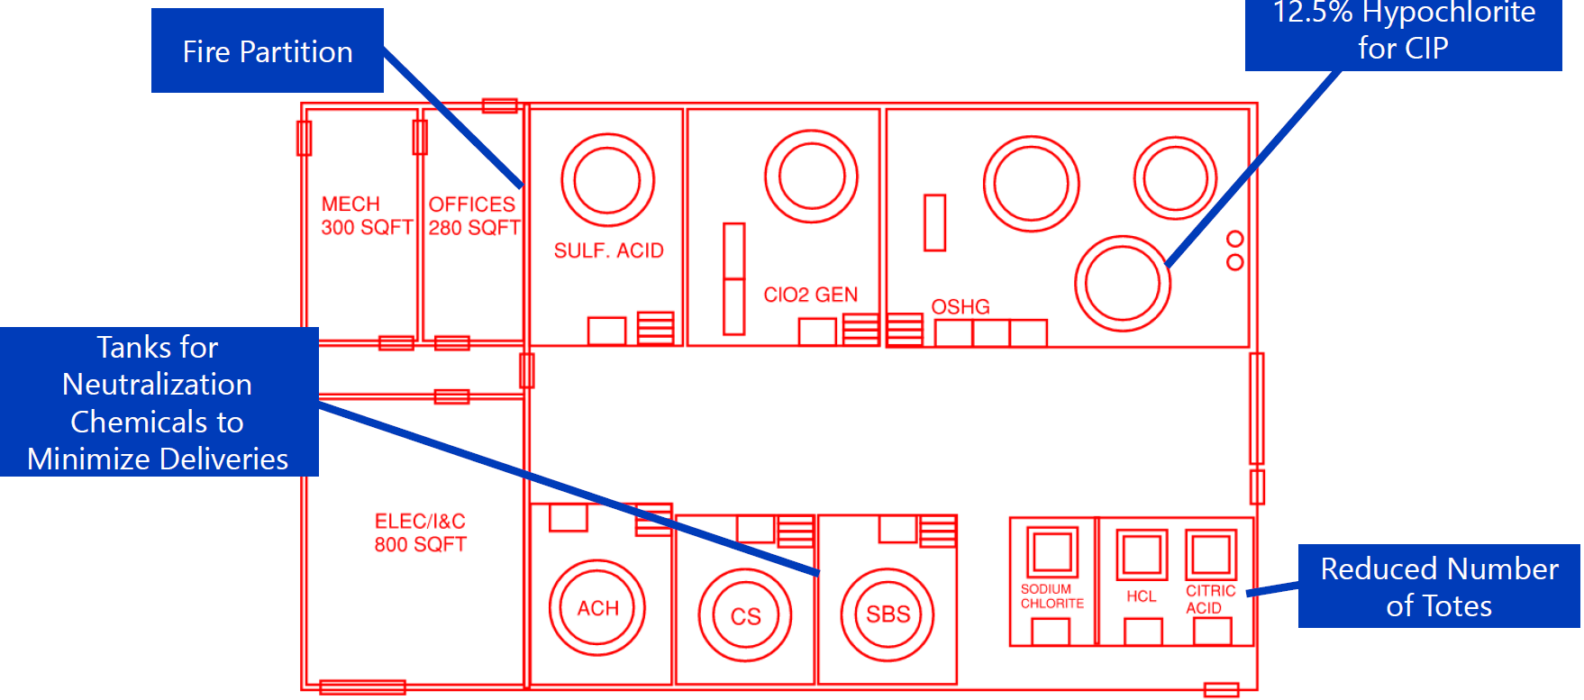
Chemical Building
  No current dedicated chemical storage
  Centralize storage, improve safety and operations
  New chemical building structure approximately 5,200 square feet
  Cost: $8,996,000
Notes:
Need for Upgrade
No dedicated chemical storage or containment currently
Chemicals stored throughout plant → safety and compliance concerns
New building will centralize chemical storage, improve safety, and facilitate operations
Design Criteria Highlights
Supports 5.4 MGD capacity
Chemicals:
Sodium hypochlorite
ACH,
Sulfuric acid
Membrane cleaning solutions
Chlorine dioxide (future)
Adds 30–40% more footprint to each layout (~6,600–7,400 sq ft)
Both alternatives adaptable to include required chemicals and equipment
MRW prefers designing with space for future ClO₂ system
Includes dedicated space for feed systems, storage tanks/totes, and backwash systems
New Structure
~5,200 sq ft; compact layout near existing hypochlorite system
Pros:
Fits better on site
Avoids major relocations
Preserves GAC access

Slide 18
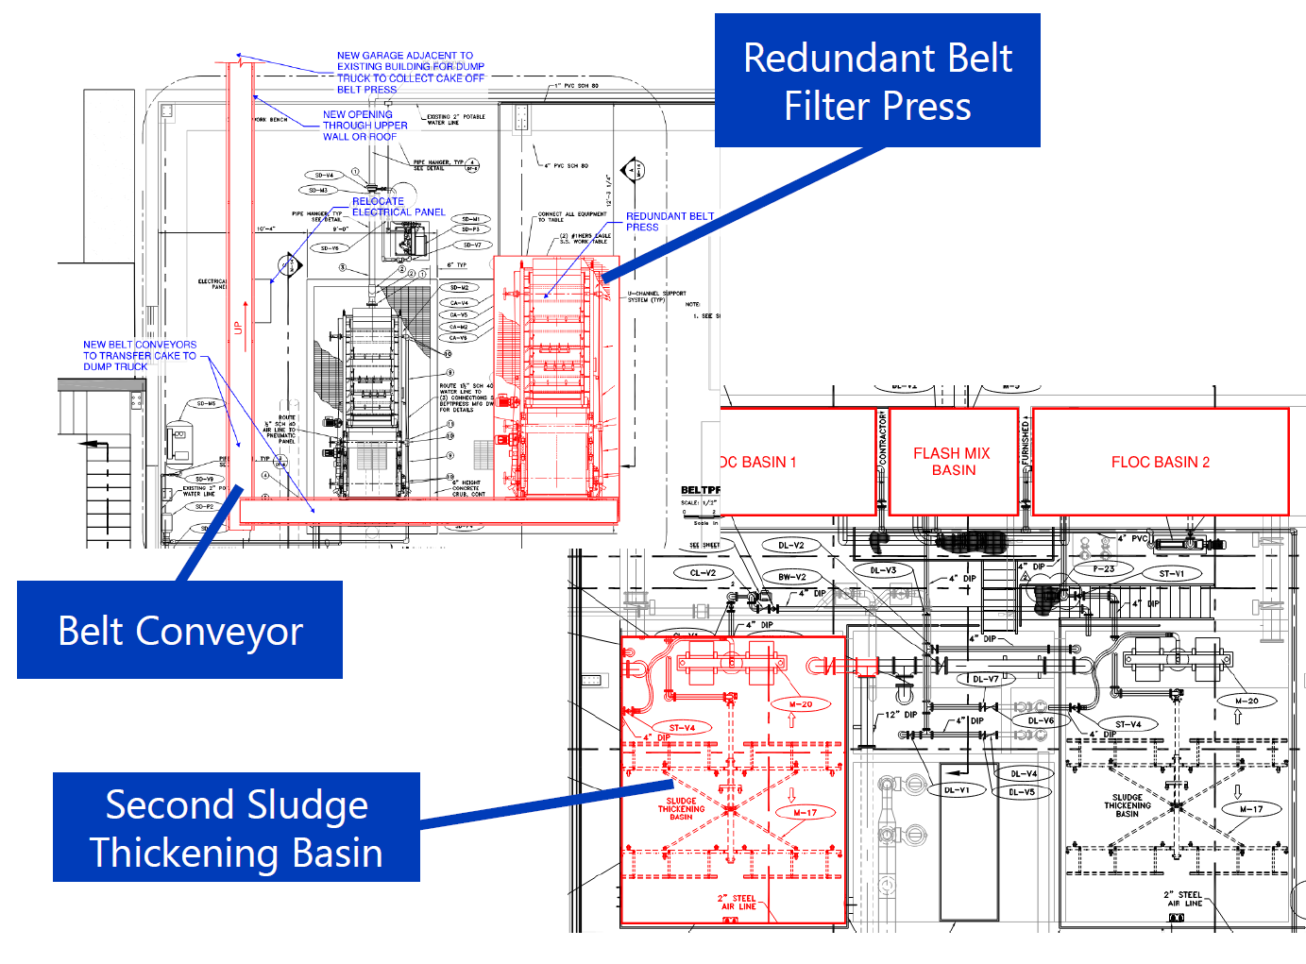
Solids Handling
  Second belt filter press
  New solids holding tank in exterior footprint
  Belt conveyor
  Repurpose sedimentation basin as second thickening basin
  Avoids significant cost of new dewatering facility
  Cost: $4,719,000
Notes:
Current Challenges
No sewer connection → limited options for pressate & decant handling
Pressate with polymer cannot return to membranes → storage limitations in winter
Insufficient equalization for GAC backwashes → operational limits
Belt press transport pump struggles with drier cake → inefficient dewatering
Mechanical Dewatering Improvements
Add second belt filter press (for redundancy)
New solids holding tank in exterior footprint
Belt conveyors transport cake to truck bay (potential reuse of GAC truck bay)
Avoids costly new dewatering facility
Thickening & Equalization Improvements
Repurpose sedimentation basin as second thickening basin
Doubles equalization to 48,000+ gallons (up to 75,000 with pre-drain)
Provides redundancy in sludge thickening
Sewer Connection Coordination
New limited sewer connection for sanitary flows + pressate + neutralized CIP waste
SBWRD concerns addressed: reduced flow estimates + continued mechanical dewatering
MRW to perform BOD sampling; chemical addition may be needed to meet 150 mg/L BOD minimum

Slide 19
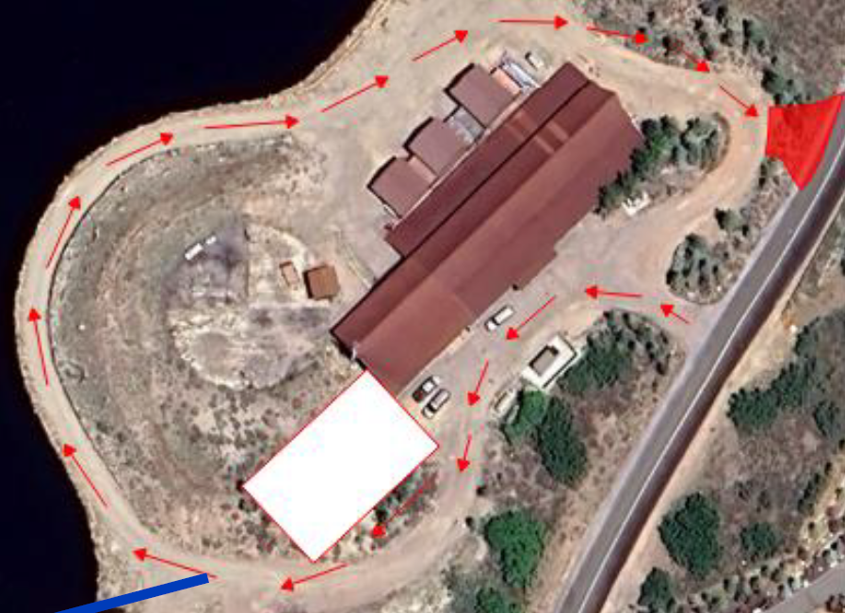
Other Civil
  New sewer connection
    Estimated impact fee: $500,000
  Reevaluate site ingress and egress
  Cost: $1,047,000

Slide 20
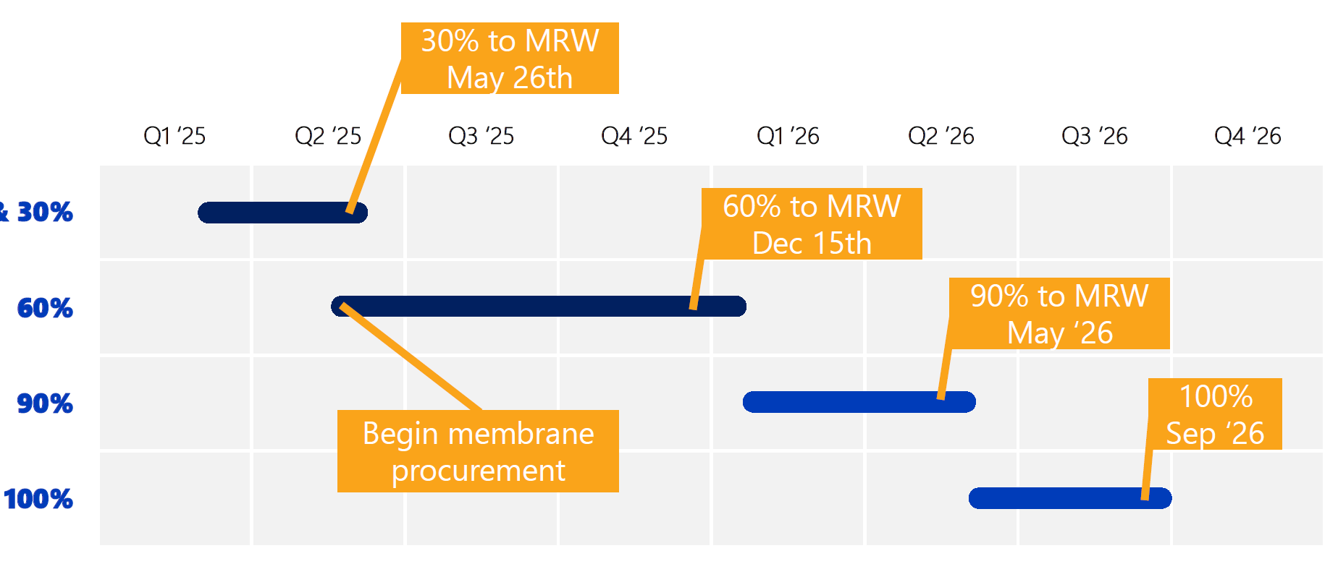
Design Schedule

Slide 21
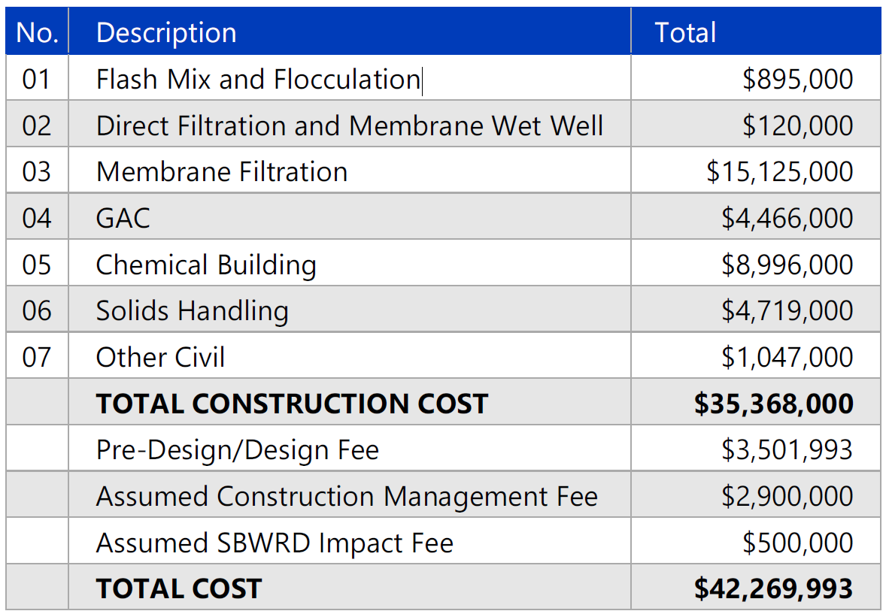
Conceptual
Cost
Summary

Slide 22

Financial Information

Slide 23
Funding Sources
Summary

Slide 24
WIFIA Loan: Scenario 1
  Expected loan amount $34.3 million
    Request a loan limit of $43 million from WIFIA
    Parameter Resolution to Council $43 million
      make interest only payments from 2027 through 2033
  Projected water rate increases to customers
    Projected rate increases from 2026 through 2028: 7% to 8% (assumes normal inflation/cost increases)
    Projected rate increases 2029 through 2034: 4% to 6% (assumes normal inflation/cost increases)
    Projected rate increases after 2034 through 2040: 3% to 5% (assumes normal inflation/cost increases)

Slide 25
WIFIA Loan: Scenario 2
  Expected loan amount $34.3 million
    Request a loan limit of $43 million from WIFIA
    Parameter Resolution to Council $55 million
      Have interest capitalized (added to the loan amount) from 2027 through 2033
  Projected water rate increases to customers
    Projected rate increases from 2027 through 2033: 3% to 5% (assumes normal inflation/cost increases)
    Projected rate increase in 2034: 8% to 9% (assumes normal inflation/cost increases)
    Projected rate increases after 2035 through 2040: 4% to 6% (assumes normal inflation/cost increases)

Slide 26
Scenario 1: Annual Parity Debt Payment

Slide 27
Scenario 2: Annual Parity Debt Payment

Slide 28
Scenario 1: Total Parity Debt

Slide 29
Scenario 2: Total Parity Debt

Slide 30
Annual Payment, Total Debt & Payback
  Scenario 1
    Maximum annual debt payments reached in 2029 at $6.18 million
    Maximum total debt reached in 2028 at $71.18 million
    Total payback of WIFIA loan over 35 years is $76.56 million (principal and interest)
  Scenario 2
    Maximum annual debt payments reached in 2035 at $5.41 million
    Maximum total debt reached in 2028 at $73.17 million
    Total payback of WIFIA loan over 35 years is $89.04 million (principal and interest)

Slide 31
Why a WIFIA Loan
  Flexible draw down
    Funds can be drawn down over time and interest is only accrued on that portion. No obligation to draw down full approved amount.
  Long amortization period
    The amortization period for the loan can be up to 35 years which includes the first payment not being required until five years after substantial completion.
  Post-closing flexibility
    A one-time rate reset after the loan is closed and before any funds are drawn is available.
    Adjustable project scope and timeline to respond to changing construction schedules.
  No prepayment penalties
    The WIFIA loan can be repaid at any time without penalty.
  Quick reimbursements
    The WIFIA loan can be repaid at any time without penalty.

Slide 32
WIFIA Closing Timeline
  June 25th – Council meeting to adopt Parameters Resolution
  July 9th – Council meeting for Public Hearing
  July through October 2025 – District works with WIFIA team on loan closing
  Q4 2025 – WIFIA loan closed
  January 1, 2027 – First draw down on WIFIA Loan.

Slide 33
Refunding Series 2023 $18 million
  Series 2023 $18 million bond directly placed with Bank of Utah
    Funded the construction of new administration building and maintenance facility
  Refunding (refinancing) savings
    Net Present Value of savings estimated at $1.12 million as of June 3, 2025
    Effective interest rate decrease from 5.17% to 4.62%

Slide 34
Questions?

